Slide 1
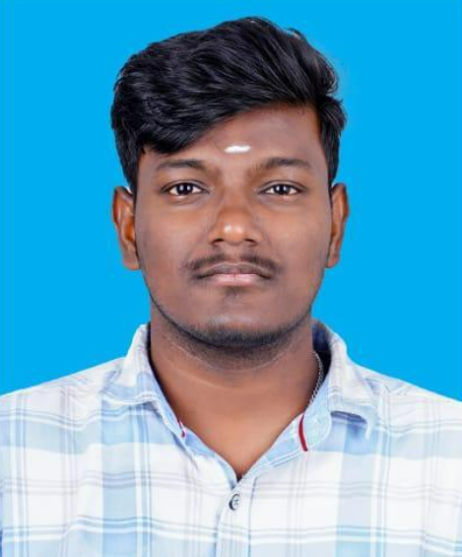
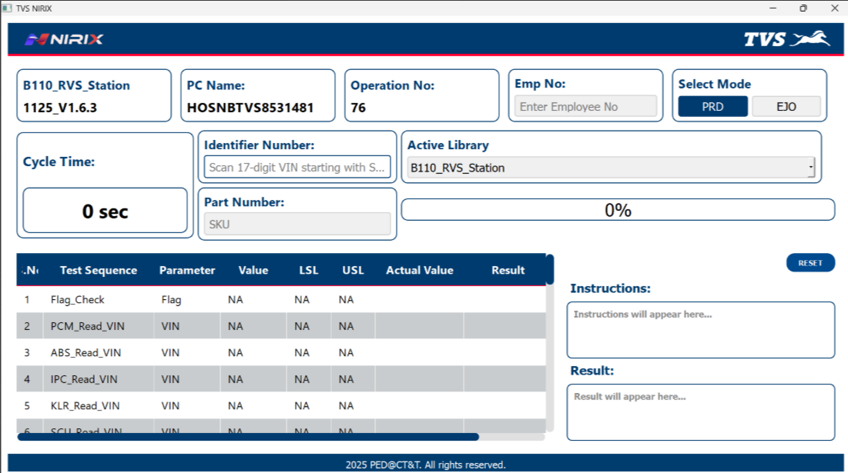
Significant contributors – March 2026
 | Name | Sri Sakthivel R
 | Emp # | 17316
 | HOD Name | J Thangarajan
 | Dept / Unit | PED - CT&T
Result
Accountability area:
Digitalization
Contribution details:
Expected lead time reduction up to 4 weeks for new controller introduction
Expected investment reduction up to 10 lakhs per model
Increased control over revision of EOL application software and program changes
Process:
P → Standardized process reduces variability in development
Q → Version control and validation steps can be built in, ensuring all parameters are correct
C → Inhouse development of NirixX Application for RVS station reduces investment to supplier from 10 to 1 Lakh
D → Faster time-to-production when software changes are needed – Expected time reduction from 16 Weeks to 4 Weeks
M → Less stress from dealing with errors or complications of 3rd-party tools
S → Reduced manual intervention minimizes risk to operators and equipment
Horizontal deployment:
Applicability | Plant 1 | Plant 4 | Plant 7 | Avigna Plant
Status | n | n | n | n
Cross functional team:
Name | Ashok L. | David Wisson
Department | D&AI | Norton

